Slide 1
MDD REVIEW-II
ANTI-LOCK BRAKING SYSTEM
GROUP MEMBERS-
ASUTOSH REDDY – RA1611018010086
MRIDAV GOEL – RA1611018010098
SATYAM DUDHAGRA – RA1611018010102
ASHISH DUBEY – RA1611018010122
PAWAN RAJ SINGH – RA1611018010146

Slide 2
contents
Introduction to ABS
Vehicle without ABS
Illustration of ABS
Components of ABS
ABS layout
Steps involved in ABS working

Slide 3
Introduction
It is an anti-skid type braking system.
It prevents the locking of the wheels due to vigorous braking.
Helps in maintaining the tractive contact with the road surface.
Offers improved vehicle control and decreases stopping distances on wet and slippery surfaces.

Slide 4
Vehicle without ABS
Larger braking distance
Loss of control over vehicle
Unable to steer while braking
Greater Slip between wheel velocity and vehicle velocity

Slide 5
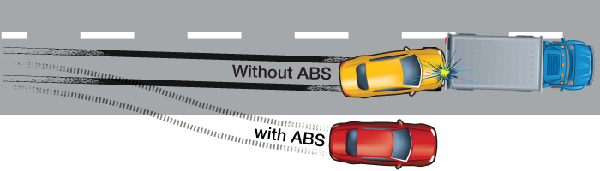
Abs working (steerability)

Slide 6
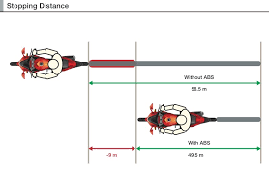
Reducing the braking distance

Slide 7
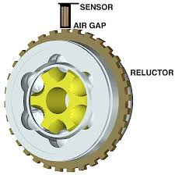
components
Brake Disc
ABS Reluctor/Toner Ring
Wheel Speed Sensor
ECU
ABS Modulator Valve
ABS Pump

Slide 8
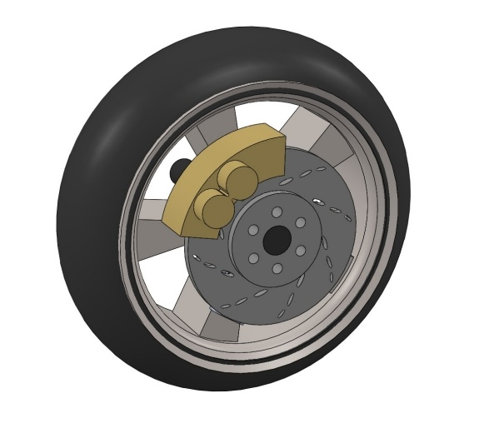
Cad model

Slide 9
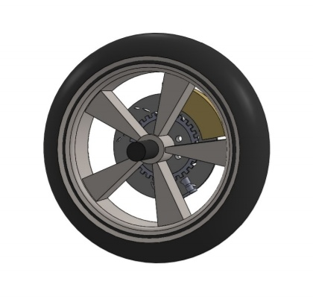
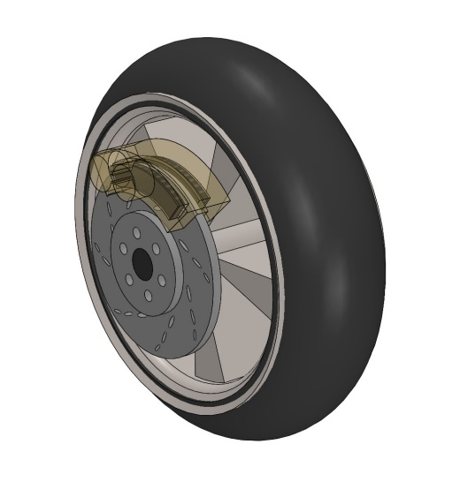

Slide 10
Difficulties faced
Difficulty in mapping mates to joints from SolidWorks CAD model to Simscape Environment.
Simscape Fluids is needed for various hydraulic valves.
Modelling Contact forces for friction braking in Simscape.

Slide 11
Model parameters (Vehicle)
SYMBOL | UNIT | VALUE | DESCRIPTION
m_{v} | kg | - | Mass of the vehicle
J_{w} | Kg.m² | - | Wheel inertia
r_{w} | m | 0.320 | Wheel radius
v₀ | m/s | 15 | Initial vehicle speed
v_{min} | m/s | 1.4 | Minimum vehicle speed for slip control
g | m/s² | 9.81 | Gravity

Slide 12
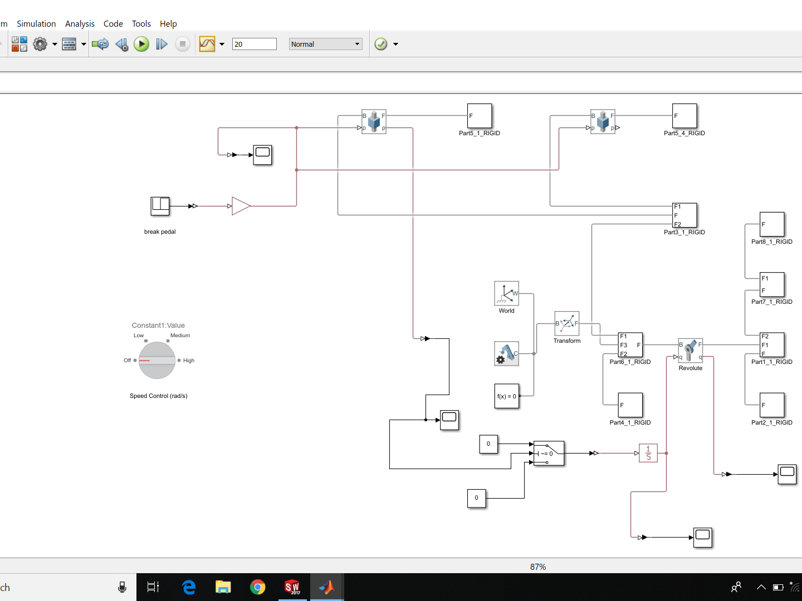

Slide 13
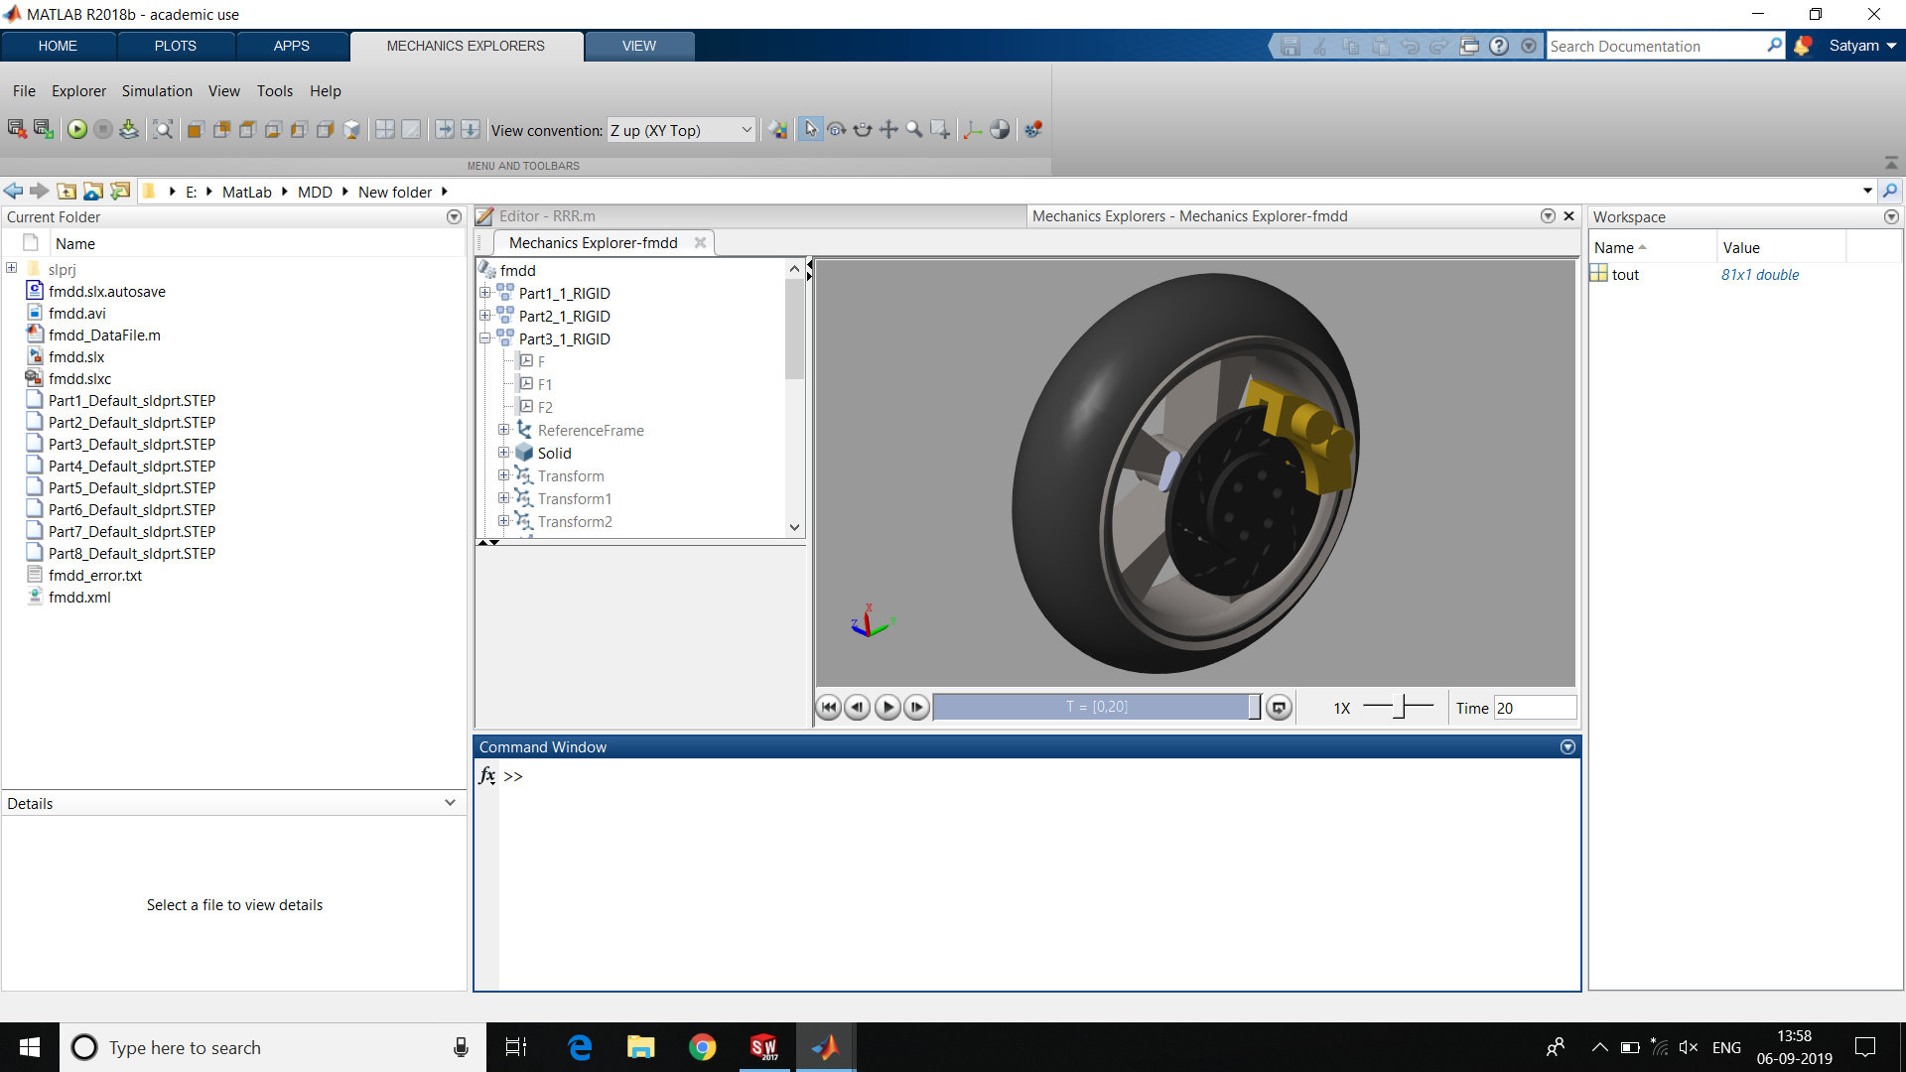

Slide 14
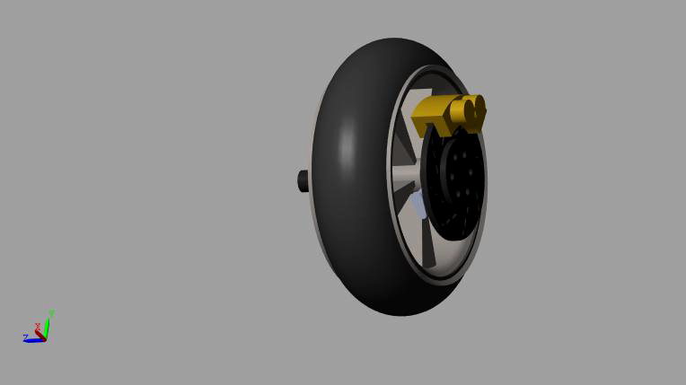

Slide 15
Model In-Loop Simulation
It is a technique used to abstract the behavior of a system or sub-system in a way that this model can be used to test, simulate and verify that model.
The ABS model is tested and verified using the mathematical model and hydraulic system as the transfer function model.

Slide 16
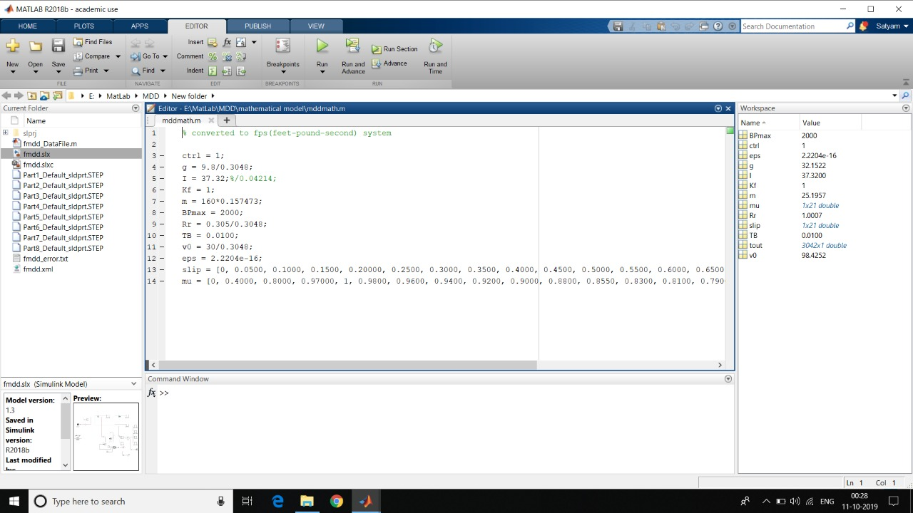
Model-in loop simulation

Slide 17
Model Parameters and Inputs
Variable/ Parameter | Description | Value used
Ctrl | ON/OFF Abs | 1/0 for on/off ABS
g | Gravitational Acceleration | 9.8 m/s^2
I | Inertia | 1.572 kg m^2 =37.32 lb ft^2
Kf | Pressure to torque | 0.00566 m^3 = 0.2 ft^3
M | Mass of Vehicle | 160 kg
BPmax | Max. Brake Torque | 2000 lb ft
Rr | Radius of wheel | 305 mm = 1 ft
Tb | Time constant of Hydraulic | 0.01
V0 | Initial Velocity | User defined (in m/s^2)
Slip | Slip values | Array (1x21)
Ds | Desired slip | 0.2
Mu | Coefficient of friction | Array (1x21)

Slide 18
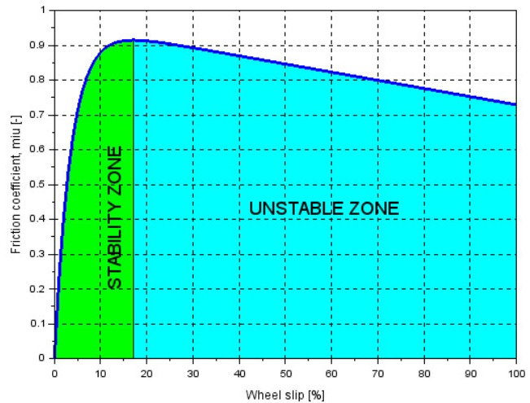
Friction coefficient v/s Slip percentage

Slide 19
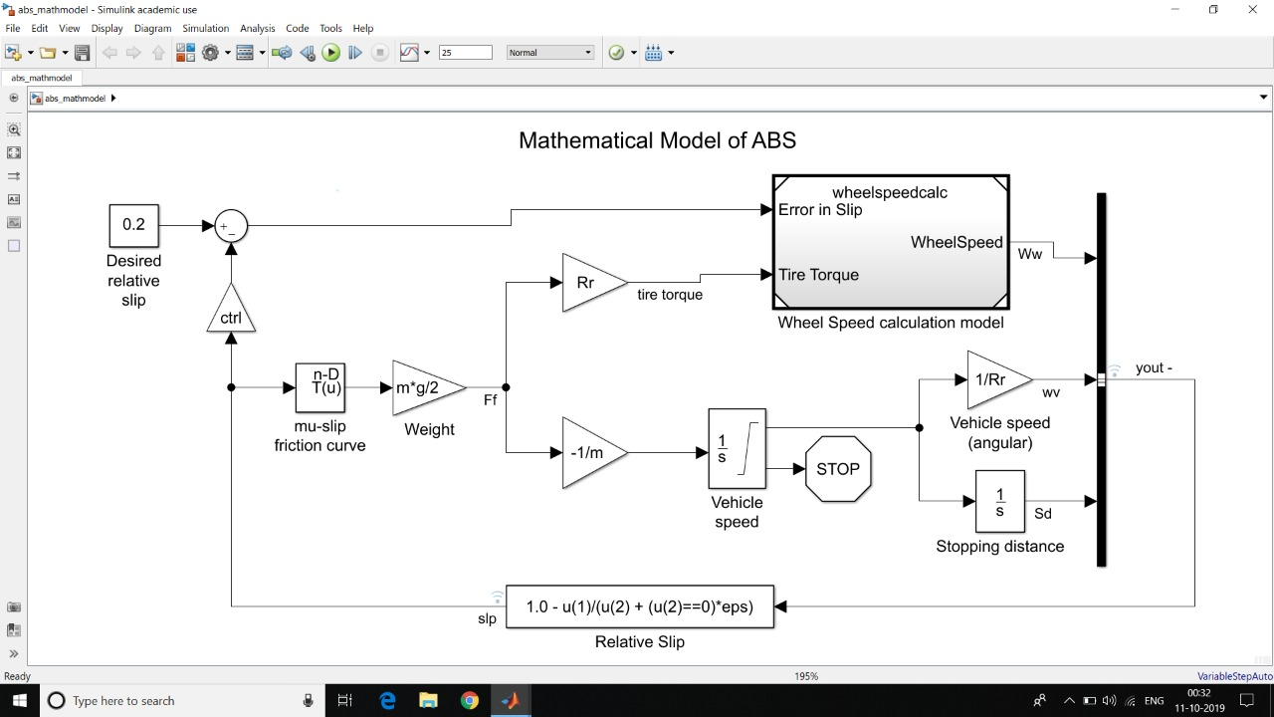

Slide 20
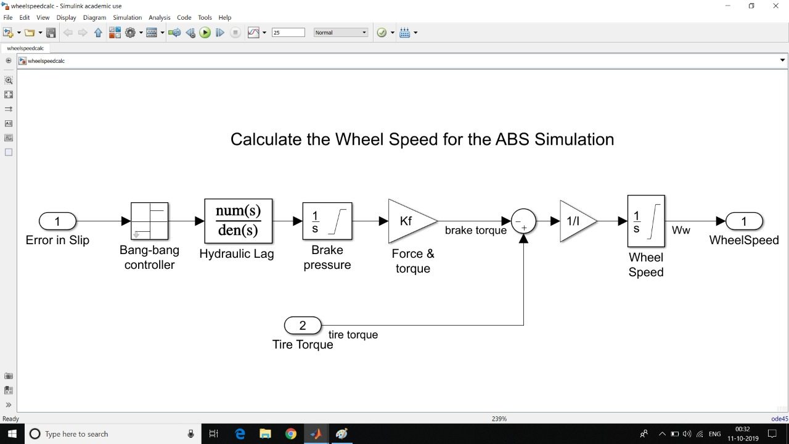

Slide 21
Problems faced in Mathematical Modelling
Not familiar with many Simulink components and their various uses.
Difficult to find slip v/s Mu graphs for different surfaces.
Conversion to Feet-pound-second system of our process parameters and inputs from MKS.
This was because of the availability of hydraulic lag transfer function in FPS units.

Slide 22
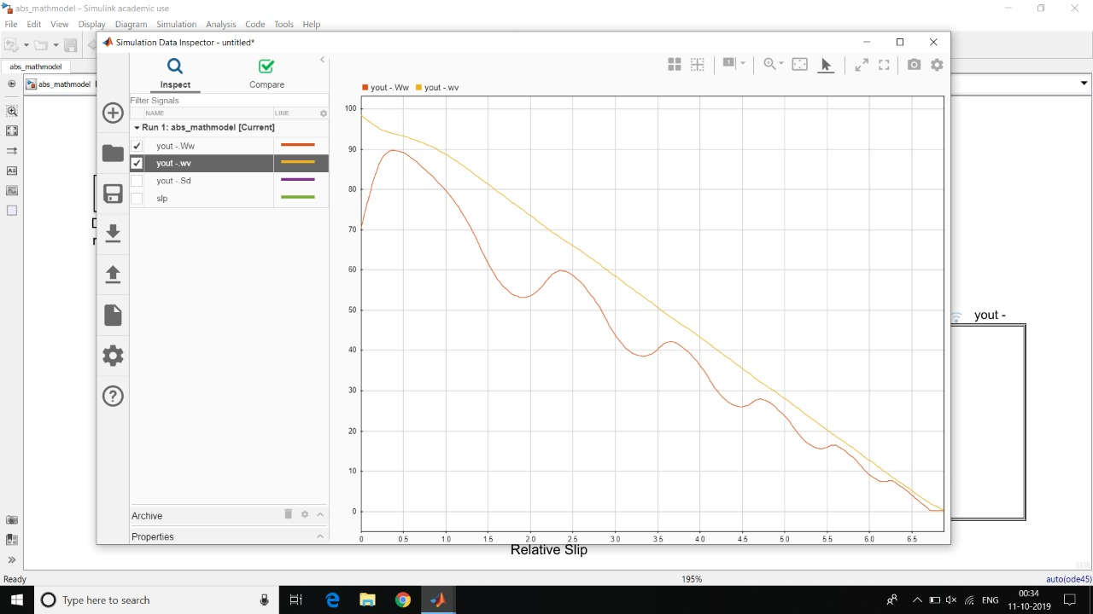
Vehicle speed and Wheel angular speed v/s time (ABS On)

Slide 23
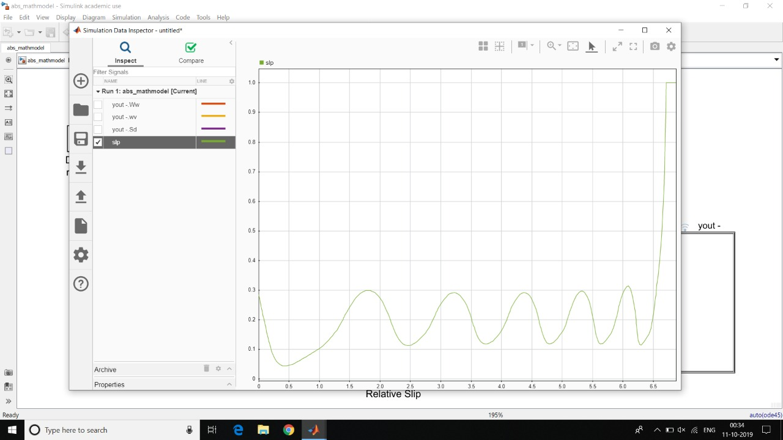
Slip v/s Time (ABS On)

Slide 24
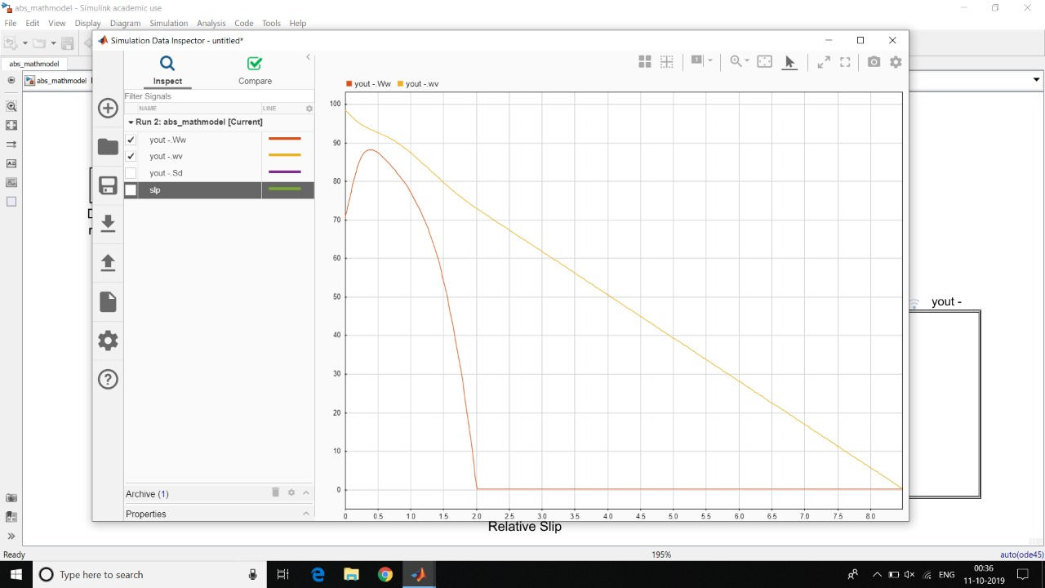
Vehicle speed and Wheel angular speed v/s time (ABS Off)

Slide 25
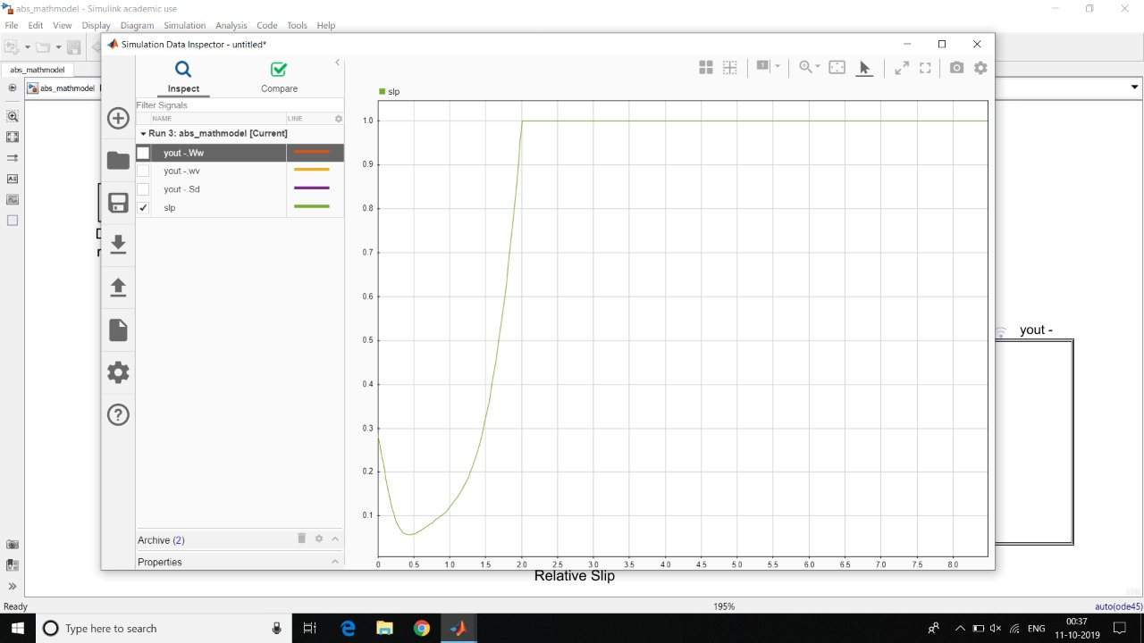
Slip v/s Time (ABS Off)

Slide 26
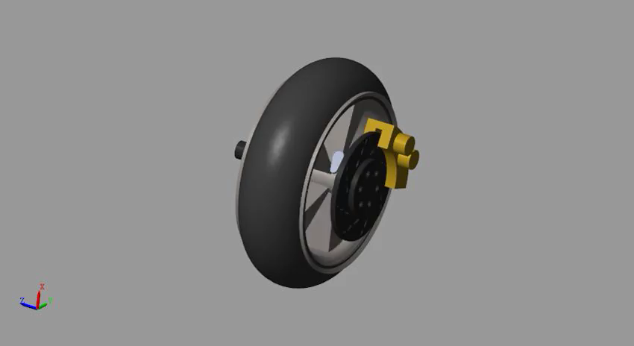
Implementation of Controller with the virtual prototype

